Slide 1
LESSON 6.1
Redox Reactions & Oxidation Numbers

Slide 2
LESSON GOALS
I can deduce oxidation states of an atom in a compound or an ion
I can identify the oxidized and reduced species and the oxidizing and reducing agents in a chemical reaction

Slide 3
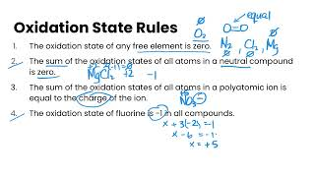
TASK 1: LEARN (MUST DO)
Individually or with a partner:
Watch the Oxidation States video
Complete the appropriate section of the Guided Note

Slide 4
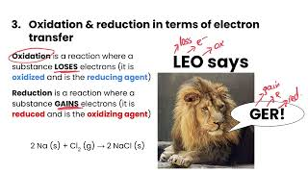
TASK 2: LEARN (MUST DO)
Individually or with a partner:
Watch the Redox Reactions video
Complete the appropriate section of the Guided Note

Slide 5
TASK 3: REVIEW (SHOULD DO)
Read pg 589 - 591 of your textbook to review the reactivity series of metals and halogens, as well as redox reactions of metals and acids
Note that these topics were covered in grade 11 - the reading now puts these in context of redox reactions!

Slide 6
TASK 4: PRACTICE
Complete the redox reactions & oxidation numbers practice (answers included)
Note: There are must do, should do, and aspire to do questions included in this practice!

Slide 7
TASK 5: MASTERY CHECK (MUST DO)
Individually:
Complete the Redox Reactions & Oxidation Numbers Mastery Check (see me when you are ready!)

